Slide 1



Branded Search Analysis
x
Placeholder

Slide 2

Relevant Branded
search terms
Branded Search
Performance
Branded Search
Above the Fold
AGENDA
Branded Search
Below the Fold
GMB Section
People Also Ask

Slide 3

What is Branded Search?
A branded keyword, or a branded search, is a search that includes the name of your company, business or brand, or an entity closely aligned with the brand of your company.

Slide 4

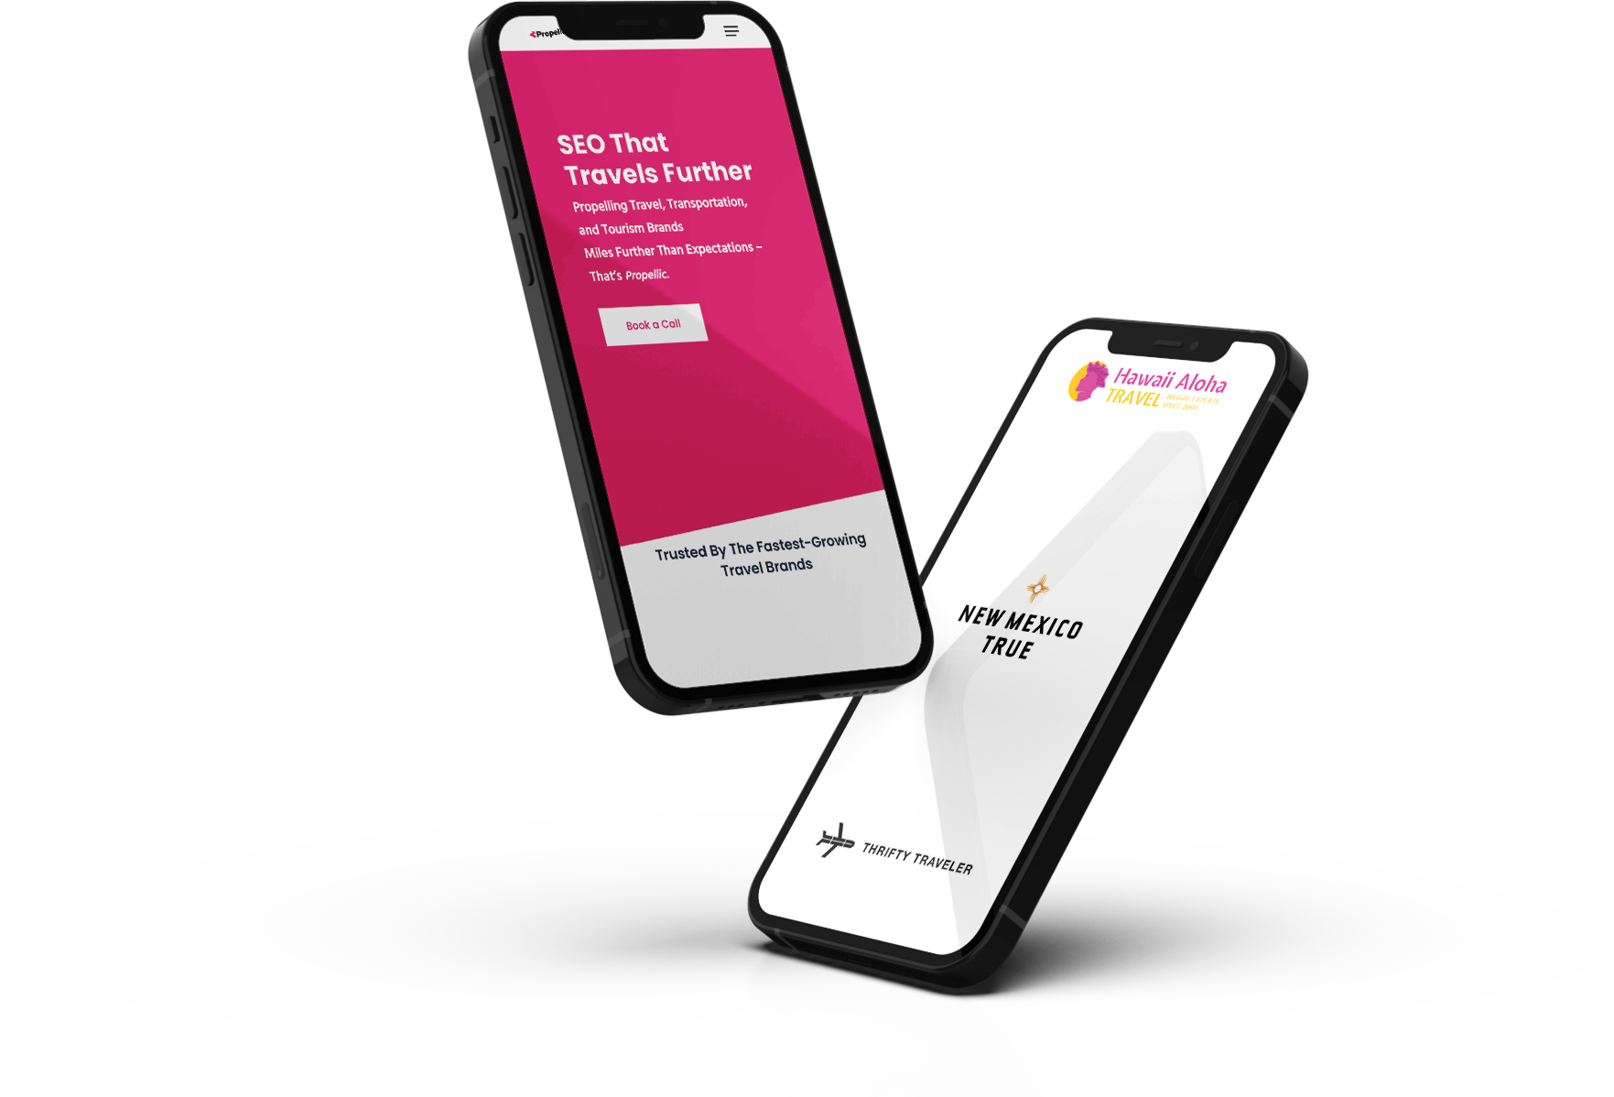
Why Does Branded Search Matter?
When someone searches for your brand, what do they find?
Branded search queries are used by people who already know your brand, or are at the very least familiar and are actively seeking information or an offering from your brand.
Those searching your brand name directly are more likely to convert into customers.
Branded results say a lot about your company, services, and products. Branded results can either encourage or deter searches from purchasing from you.

Slide 5
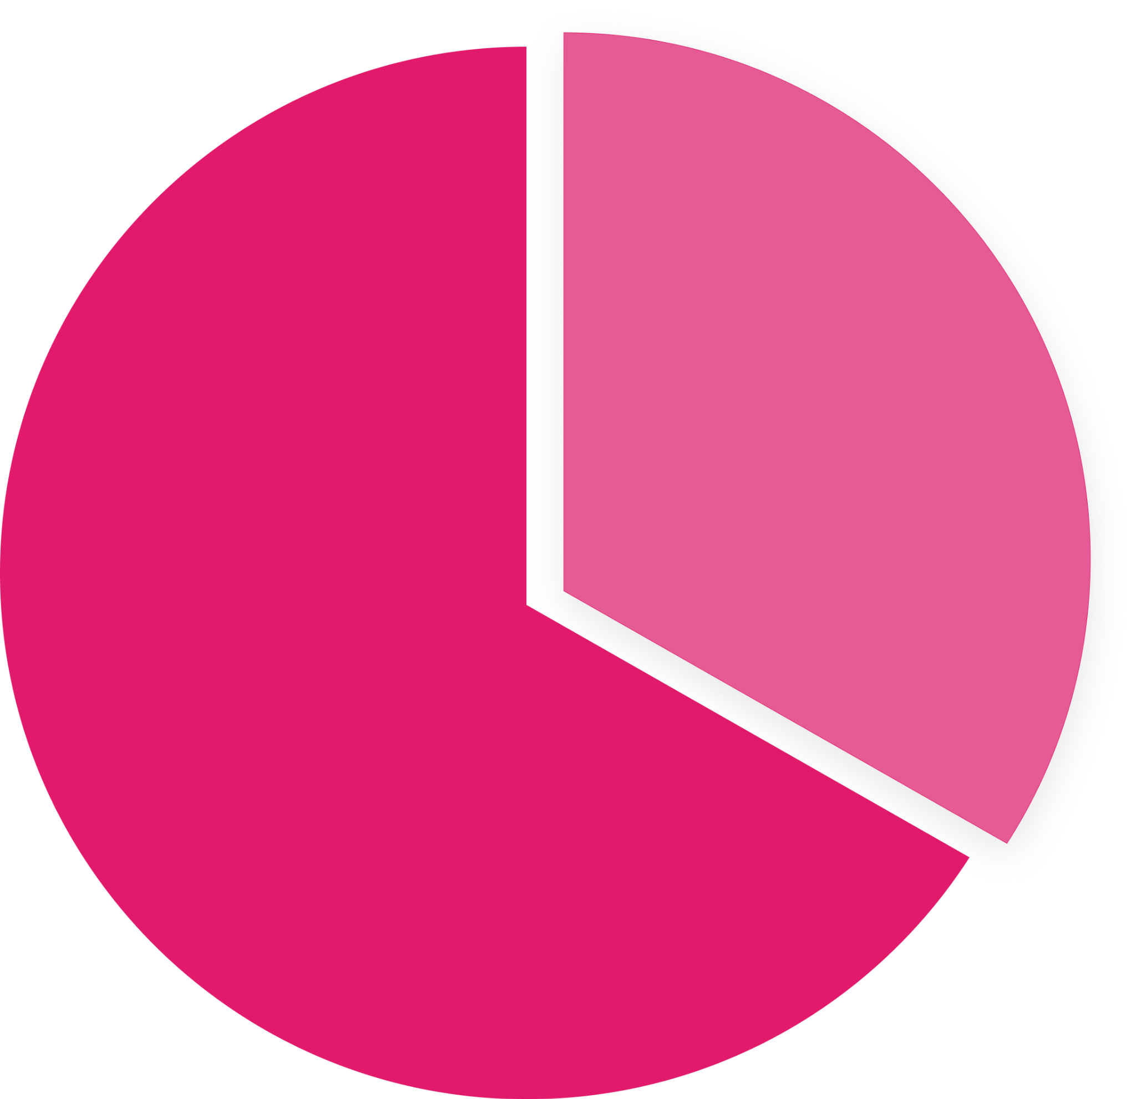
Your Traffic Breakdown
Unbranded
33.3
Unbranded
66.7
Branded vs. Unbranded Traffic

Slide 6
Your Branded Search Terms
BRANDED SEARCH TERM | SEARCH VOLUME
BRANDED SEARCH TERM | SEARCH VOLUME
grand european travel | 1600
grand european travel | 1600
grand european tours | 300
grand european tours | 300
get tours | 400
get tours | 400
getours | 200
getours | 200
grand european travel reviews | 90
grand european travel reviews | 90
getours reviews | 40
getours reviews | 40
get tours reviews | 40
get tours reviews | 40
get tours 2022 | 30
get tours 2022 | 30
ge tours | 30
ge tours | 30
grand european tours reviews | 10
grand european tours reviews | 10

Slide 7
Competitive Brand Search Volume Comparison
LOGO
LOGO
LOGO
{Competitor 1}
{Competitor 2}
1600/month
1600/month
VS
{Client Website}
1600/month
LOGO
LOGO
{Competitor 3}
{Competitor 4}
1600/month
1600/month

Slide 8
Competitive Brand Search Volume Comparison
{Competitor 1}
1600/month
{Competitor 2}
VS
1600/month
LOGO
{Competitor 3}
{Client Website}
1600/month
1600/month
{Competitor 4}
1600/month

Slide 9

Branded Search Example

Slide 10
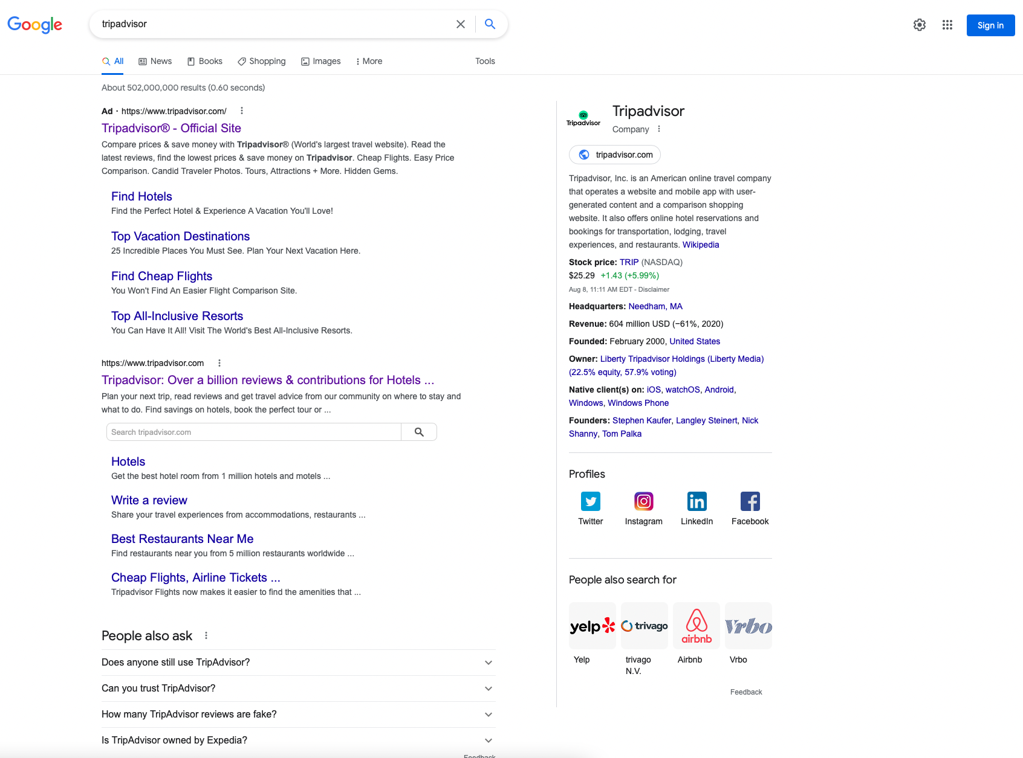
Example: Branded Search Results
1
4
Branded Advertisement
Branded Organic Result With Search & Sitelinks
People Also Ask
Knowledge Panel
2
3

Slide 11
Knowledge Panel

Slide 12
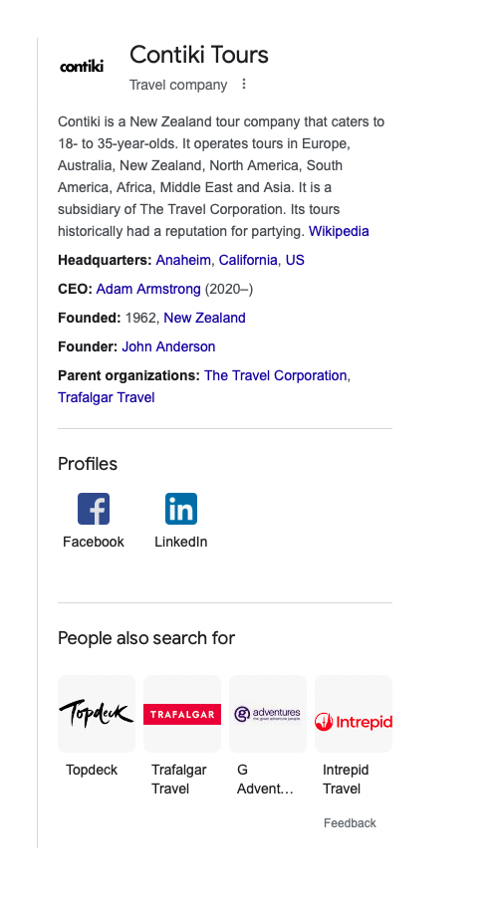
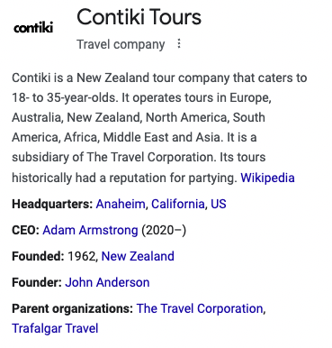
Contiki’s Knowledge Panel
✔
✔
✔
✔
✔
X
X
✔
X
✔

Slide 13
Missing Knowledge Graph Features
Stock Symbol
Sales Phone Number
Founding Date
Foundres
Products

Slide 14
Local Result

Slide 15
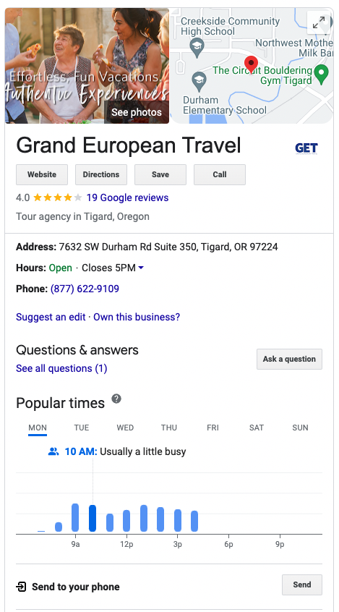
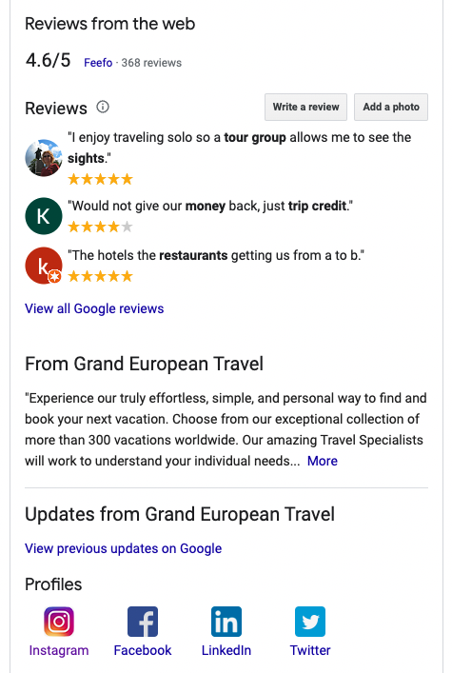
GET’s Knowledge Panel
Solicit positive reviews
Add correct hours
Add phone number
Add photos

Slide 16
Structured Data

Slide 17
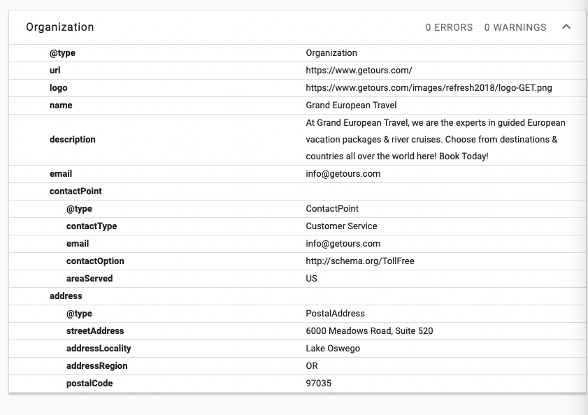
Current Markup Usage

Slide 18
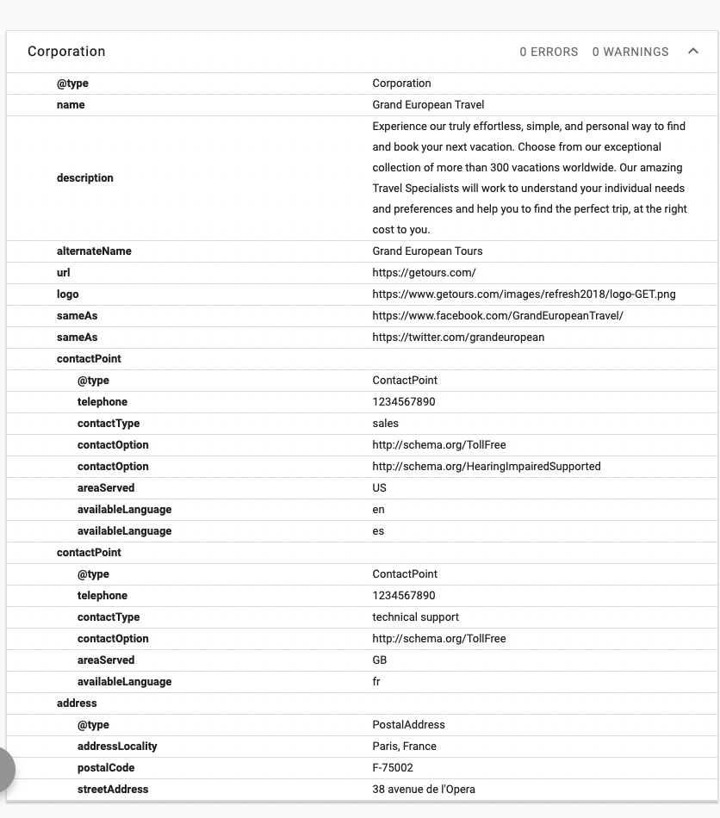
Suggested Markup Usage
Change to Corporation
Add Address
Add Contact Points
Add Social Profiles
Remove XYZ

Slide 19
SERP Ownership

Slide 20

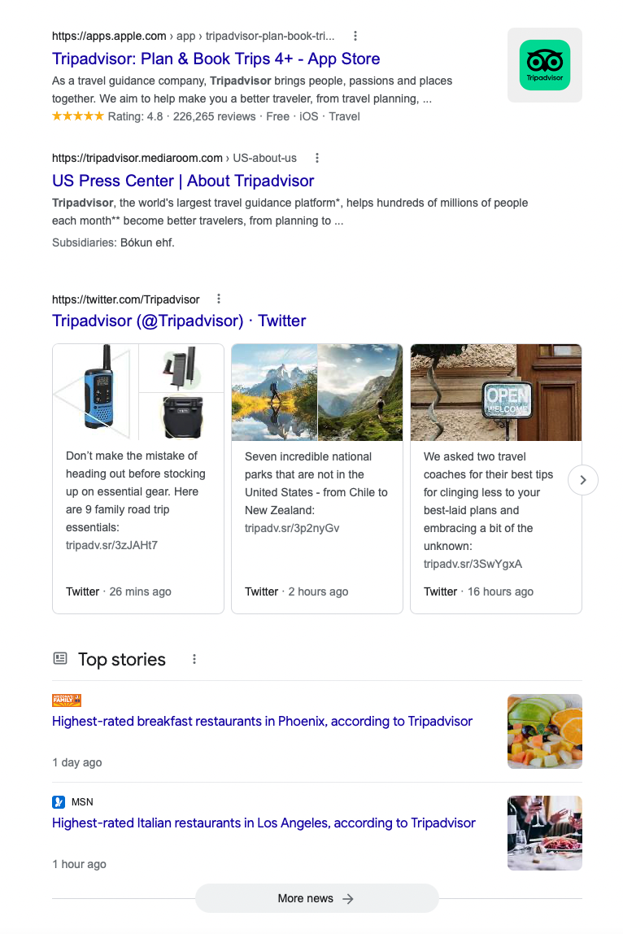
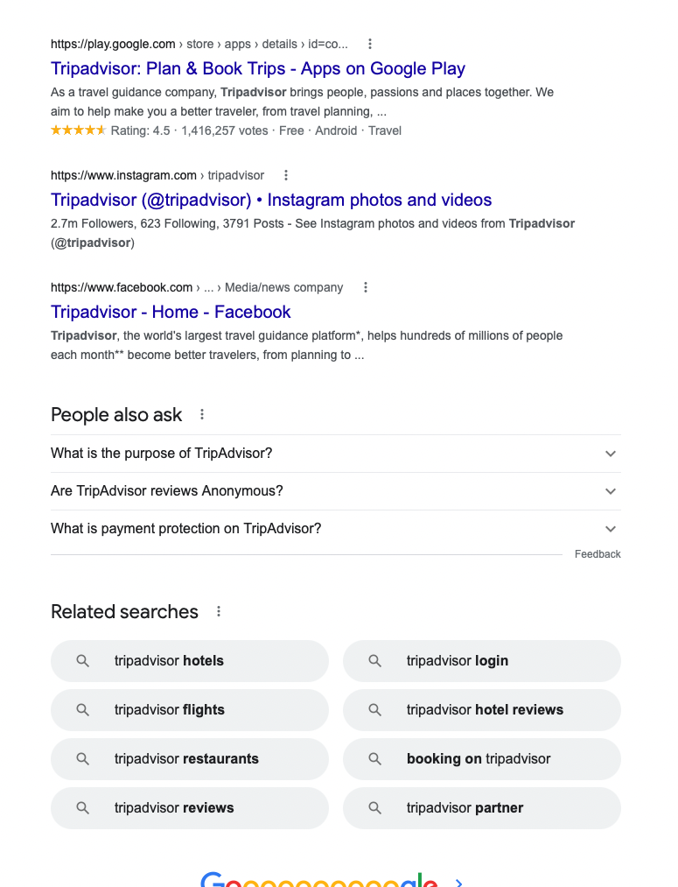
Owned vs. Unowned Properties on Page One

Slide 21

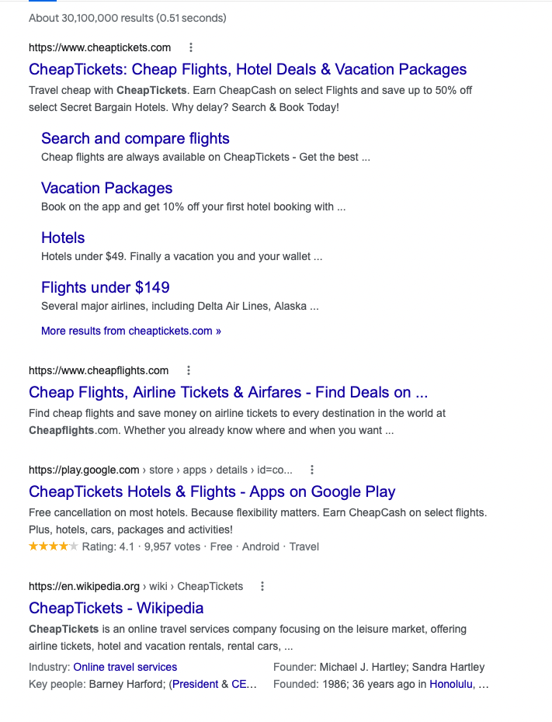
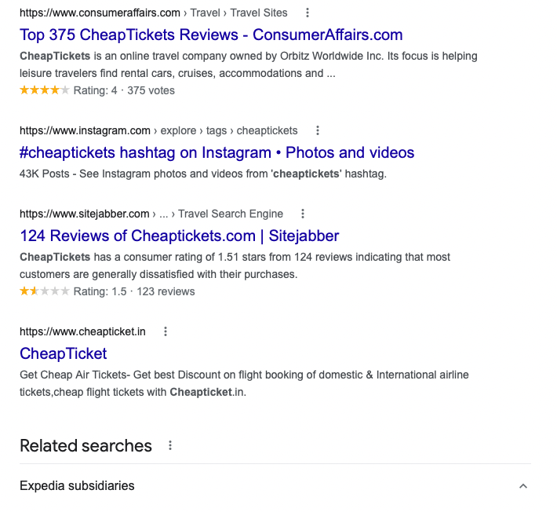
Owned vs. Unowned Properties on Page One

Slide 22
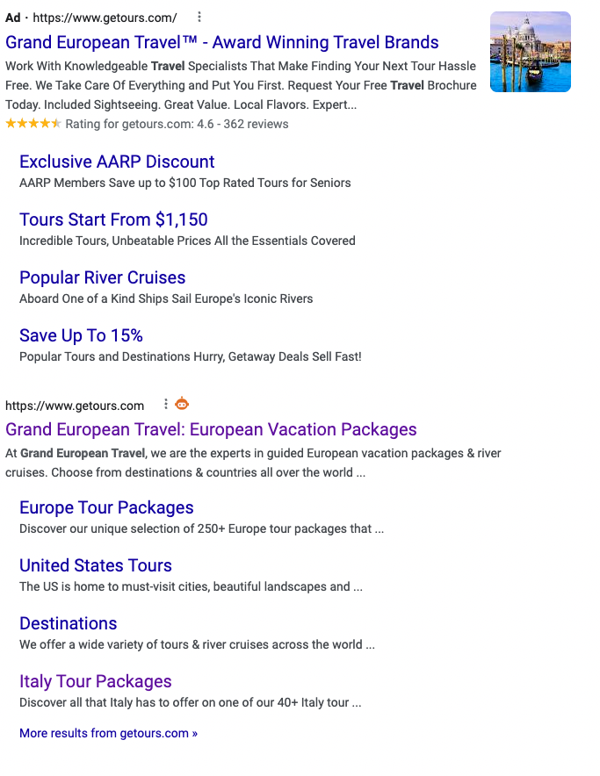
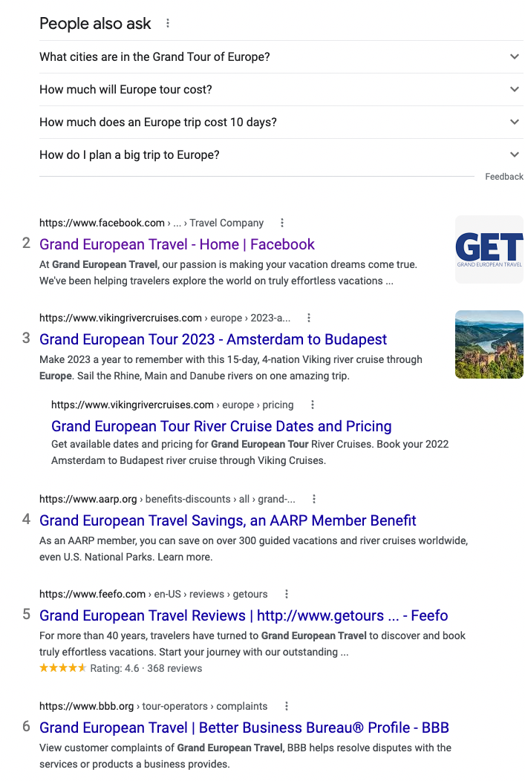
SERP Ownership Review

Slide 23
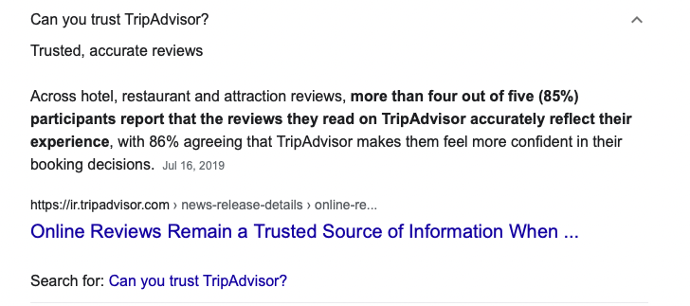
People Also Ask Ownership Example
In In this example, a potentially damaging Q&A is owned by TripAdvisor’s web properties, allowing them to control the narrative.

Slide 24
People Also Ask Ownership Review
People also ask
How do I plan a European tour?
What is the cheapest country in Europe to visit?
What is the best way to tour Europe for the first time?
How much would it cost to travel across Euroope?
Which is the most beautiful country in Europe?
How much should you save to travel Europe
What is the cheapest city in Europe to fly into?
How do you plan a trip to Europe on a budget?
Which country is the most expensive in Europe?

Slide 25
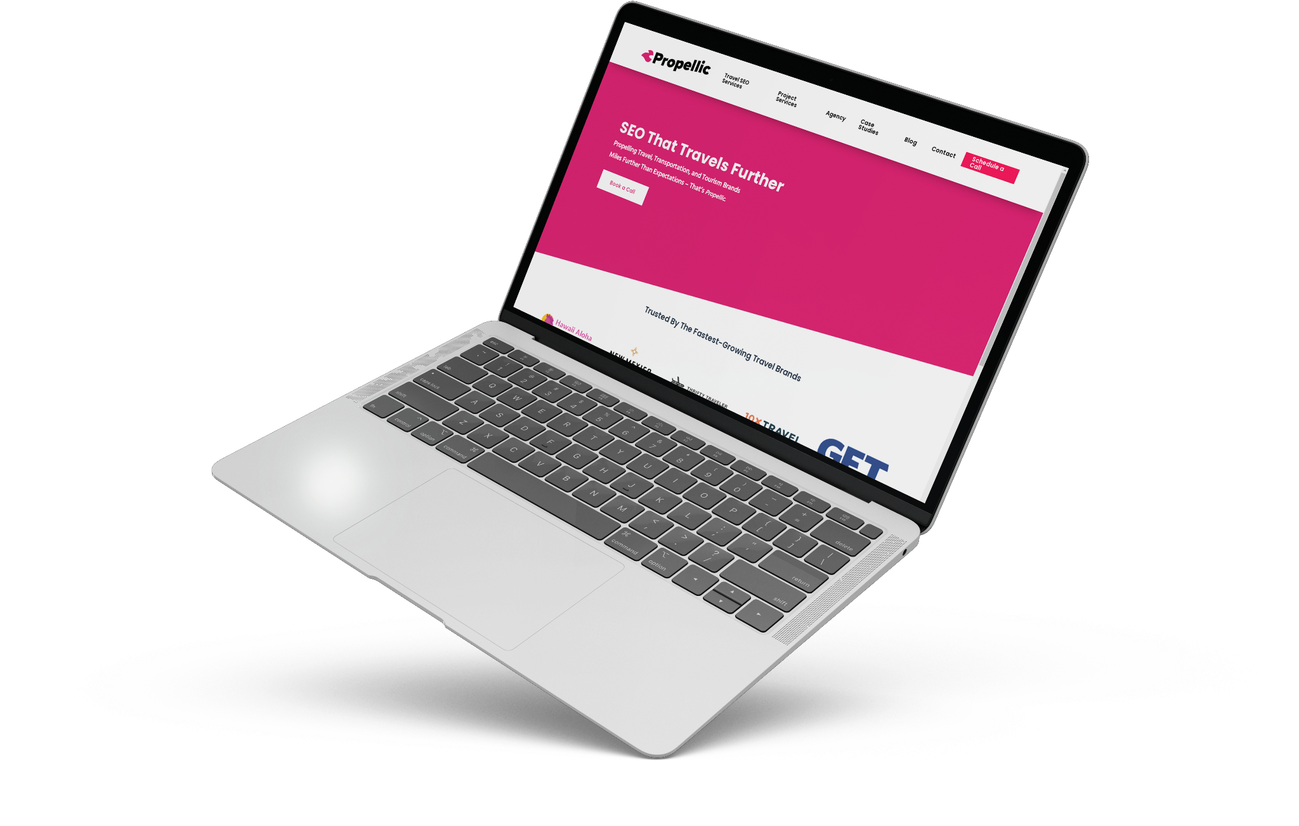
SERP Ownership Recommendations
Create Page XYZ
Drive links to page XYZ
Remove link to BBB from Website
Answer People Also Ask Questions:
Question 1
Question 2
Question 3
Question 4

Slide 26
Your Web Properties

Slide 27
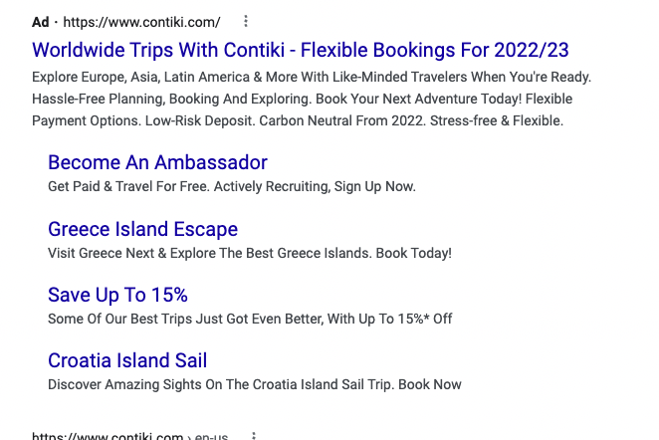
Paid Search Branded Result
Change to Corporation
Add Address
Add Contact Points
Add Social Profiles
Remove XYZ

Slide 28
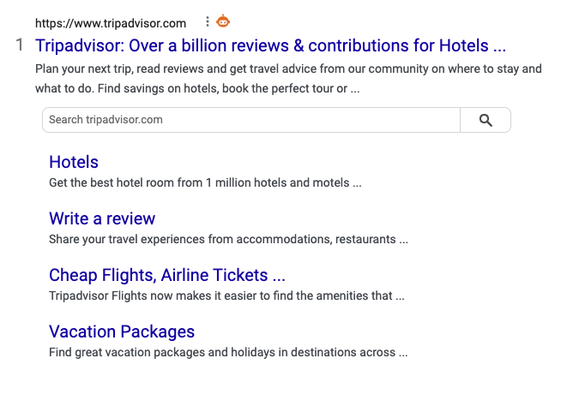
Organic Search Branded Result
Change to Corporation
Add Address
Add Contact Points
Add Social Profiles
Remove XYZ

Slide 29
Recommendation Summary
Create Page XYZ
Drive links to page XYZ
Remove link to BBB from Website
Answer People Also Ask Questions:
Question 1
Question 2
Question 3
Question 4

Slide 30

THANK YOU
www.propellic.com

